Slide 1
Numerical Modelling of SOI
Integrated Ising Machine
Yanxia Lu
Chair of Radio Frequency and Photonics Engineering

Slide 2
Outline
Hewlett Packard Integrated Ising Machine (HPIIM)
Modelling and Simulation of Tunable Bistability
Integrated Ising Machine Based on Nonlinear Silicon-on-insulator (SOI) Microring Resonators (MRR)
Notes:
Application of CIM to Optimization Problems

Slide 3
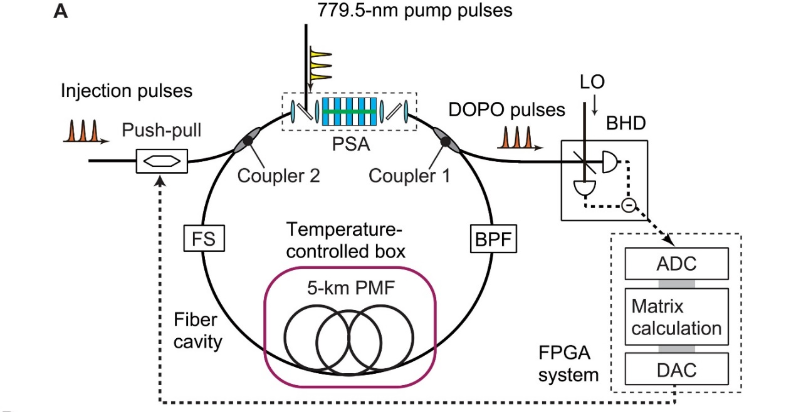
Nippon Telegraph and Telephone Coherent Ising Machine (NTT CIM)
Fiber Based Time-multiplexed CIM [1]
FS, fiber stretcher.
LO, local oscillator.
BPF, band pass filter.
PSA, phase-sensitive amplifier.
BHD, balanced homodyne detector.
ADC, analog-to-digital converter.
DAC, digital-to-analog converter.
PMF, polarization-maintaining fiber.
DOPO, degenerate optical parametric oscillator
Pump
Signal
Idler
[1] Honjo, Toshimori, et al. "100,000-spin coherent Ising machine." Science advances 7.40 (2021): eabh0952.

Slide 4
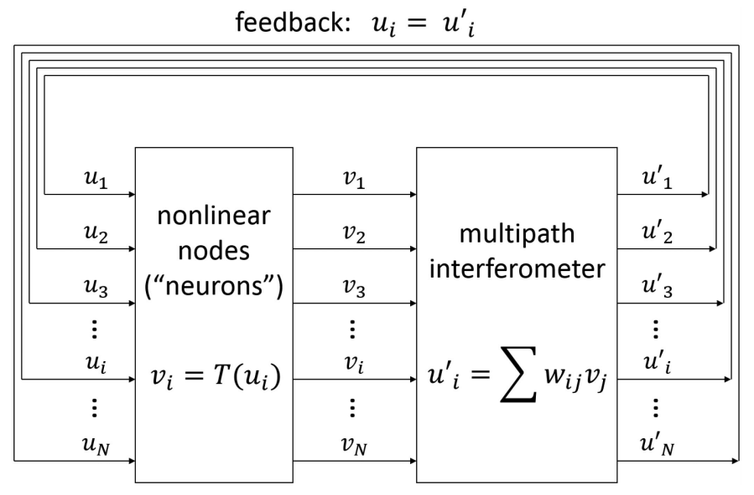
Hewlett Packard Integrated Ising Machine (HP IIM)
Chip-based All-optical Ising Machine [2]
Spatial-multiplexed without DOPO
Feedback paths connecting the outputs of the interferometer to the inputs of the nodes
A layer of nodes with nonlinear transfer function.
A multipath interferometer based on an MZI lattice that applies analog weights to the node outputs.
[2] Tezak, Nikolas, et al. "Integrated coherent Ising machines based on self-phase modulation in microring resonators." IEEE Journal of Selected Topics in Quantum Electronics 26.1 (2019): 1-15.

Slide 5
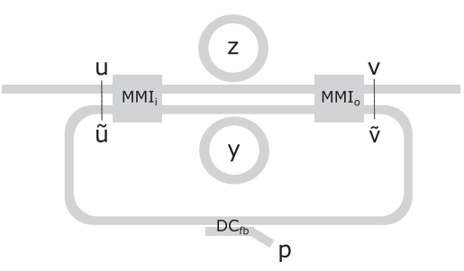
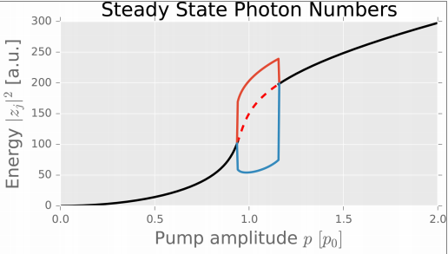
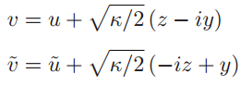
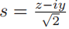
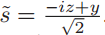
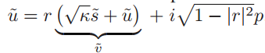
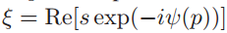
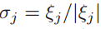
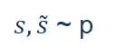
Hewlett Packard Integrated Ising Machine (HP IIM)
Photonic integrated circuit (PIC) with two coupled identical MRRs
$s, \tilde{s}$ ~ p
Input
Output
u=u‘(p)
v(p)
spin interaction through
Feedback coupling
r
u‘
DC
Control Pump
pump
Supermode:
Orthorgonal mode:
Spin encoding with s mode:
r-value of the directional coupler determines feedback transmission amplitude.
(+/- ~ 0/π)

Slide 6
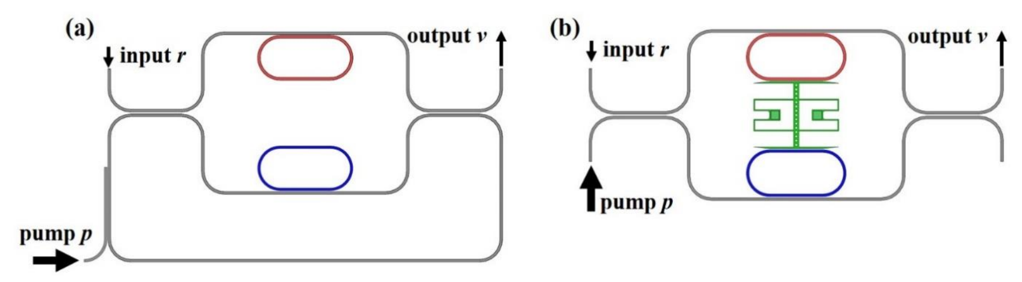
Extension of HPCIM
Integrated Ising machine based on the mechanical Kerr effect [3]:
Ising spin realized by the optomechanical effect:
Optomechanical actuator driven by the optical gradient force changes the effective index of both resonators.
Feedback is coupled directly by mechanical spring force.
(a) Photonic circuit of optical-Kerr CIM as in HPIIM. (b) Photonic circuit of mechanical-Kerr CIM in [3].
[3] Rah, Yoonhyuk, et al. "Low power coherent ising machine based on mechanical kerr nonlinearity." Physical Review Letters 130.7 (2023).
Notes:
This low-power operation prevents undesired high power side effects such as two-photon absorption, free carrier generation, and thermal heating.
the imbalance of optical power introduces a nonzero net optical gradient force and pulls the actuator towards one of the resonators. The displacement simultaneously alters the effective index of both resonators, driving the symmetry
breaking process further on until a steady state is reached where the net optical gradient force is balanced by the mechanical spring force. At the steady state, the output power reaches a nonzero level along with a large resonance detuning split.

Slide 7
Optical Nonlinearities in Silicon Photonics
Silicon and silicon-based platforms have strong optical nonlinearities:
Kerr Effect
A change in the refractive index in response to an applied electric field.
Free Carrier Effect (FCE)
A change in the refractive index in response to the density of free carriers.
FCE includes Free-carrier absorption (FCA) and free-carrier dispersion (FCD).
Consider only FCE induced by two-photon absorption (TPA).
Thermo-optic effect (TOE)
A change in the refractive index in response to temperature.
Consider only the heat generated from absorption — TPA and FCA.

Slide 8
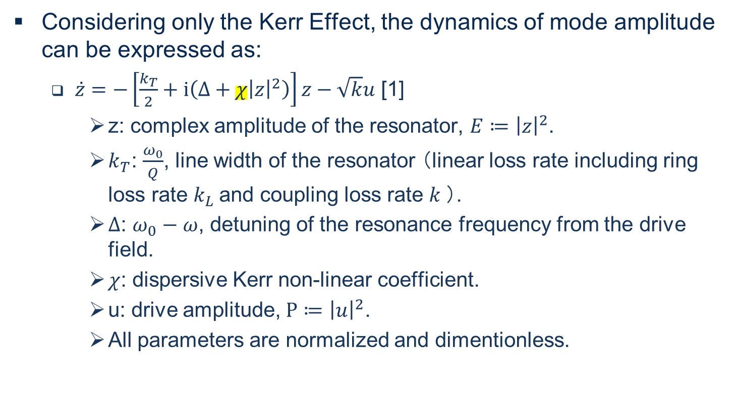
Single Resonator with Only Kerr Effect
Considering only the Kerr Effect, the dynamics of mode amplitude can be expressed as:
$\dot{z}=−\left[\frac{k_{T}}{2}+i\left(Δ+χ{\left|z\right|}^{2}\right)\right]z−\sqrt{k}u$ [1]
z: complex amplitude of the resonator, $E≔{\left|z\right|}^{2}$.
$k_{T}$: $\frac{ω_{0}}{Q}$, line width of the resonator （linear loss rate including ring loss rate $k_{L}$and coupling loss rate $k$）.
$Δ$: $ω_{0}−ω$, detuning of the resonance frequency from the drive field.
$χ$: dispersive Kerr non-linear coefficient.
u: drive amplitude, $P≔{\left|u\right|}^{2}$.
All parameters are normalized and dimentionless.
n_kerr instead of xi
[2] Tezak, Nikolas, et al. "Integrated coherent Ising machines based on self-phase modulation in microring resonators." IEEE Journal of Selected Topics in Quantum Electronics 26.1 (2019): 1-15.

Slide 9
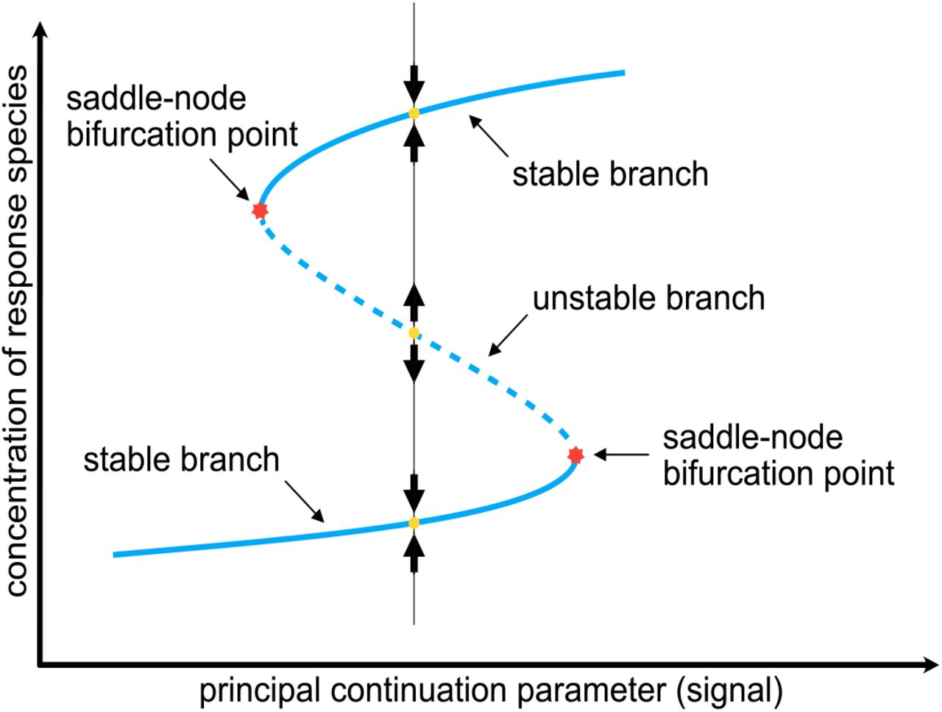
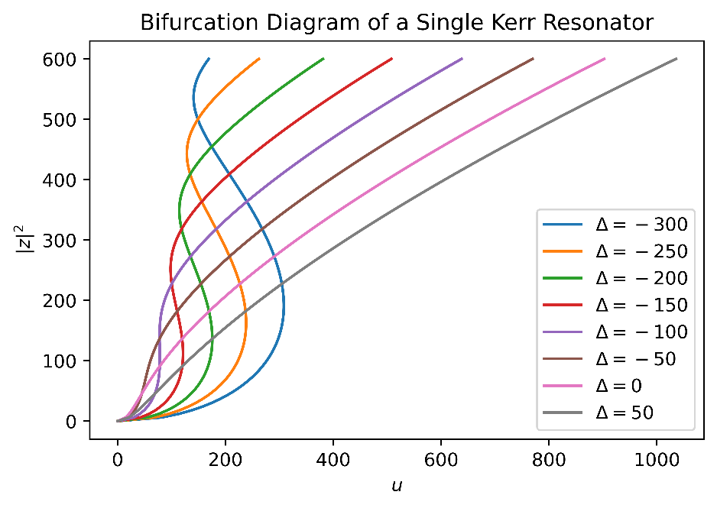
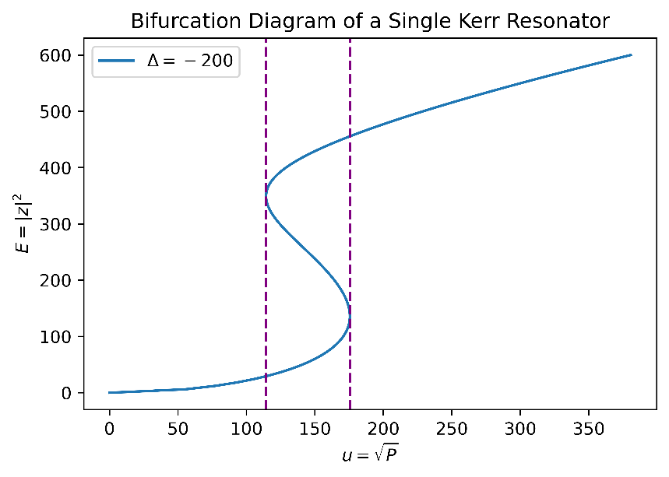
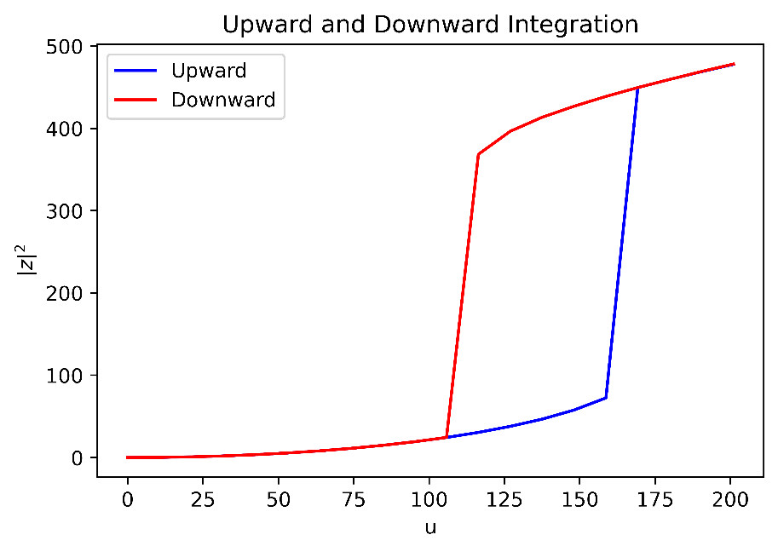
Bifurcation Diagram and Bistability
Reyes, Brandon C., Irene Otero-Muras, and Vladislav A. Petyuk. "A general technique for the detection of switch-like bistability in chemical reaction networks governed by mass action kinetics with conservation laws." bioRxiv (2020): 2020-11.

Slide 10
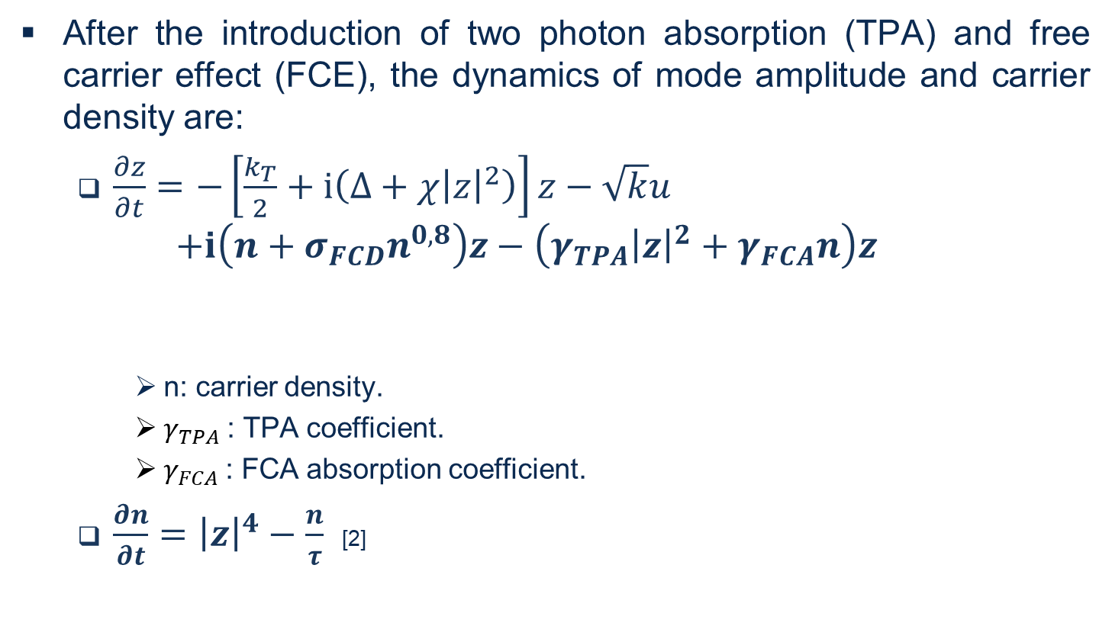
Single Resonator with Kerr and FCE Effect
After the introduction of two photon absorption (TPA) and free carrier effect (FCE), the dynamics of mode amplitude and carrier density are:
$\frac{∂z}{∂t}=−\left[\frac{k_{T}}{2}+ⅈ\left(Δ+χ{\left|z\right|}^{2}\right)\right]z−\sqrt{k}u$
$$+ⅈ\left(n+σ_{FCD}n^{0,8}\right)z−\left(γ_{TPA}{\left|z\right|}^{2}+γ_{FCA}n\right)z$$
n: carrier density.
$γ_{TPA}$: TPA coefficient.
$γ_{FCA}$: FCA absorption coefficient.
$\frac{∂n}{∂t}={\left|z\right|}^{4}−\frac{n}{τ}$ [2]
Kerr-Nonlinear Resonator
refractive index change induced by FCD [4]
loss caused by TPA and FCA [4]
[4] Zhang, Libin, et al. "Multibistability and self-pulsation in nonlinear high-Q silicon microring resonators considering thermo-optical effect." Physical Review A—Atomic, Molecular, and Optical Physics 87.5 (2013): 053805.
Notes:
“In silicon, the density of free carriers in the conduction band dictates the absorption and refractive index of the material. Free-carrier absorption (FCA) and free-carrier dispersion (FCD) are collectively termed free-carrier effects. FCE may be induced either electrically, by injecting carriers via a pn-junction, or optically by photo-generating free carriers via linear or nonlinear absorption. Since Si is transparent at infrared wavelengths, we will assume TPA as the carrier generation mechanism.” -- Temporal coupled-mode theory in nonlinear resonant photonics: From basic principles to contemporary systems with 2D materials, dispersion, loss, and gain (2024)

Slide 11
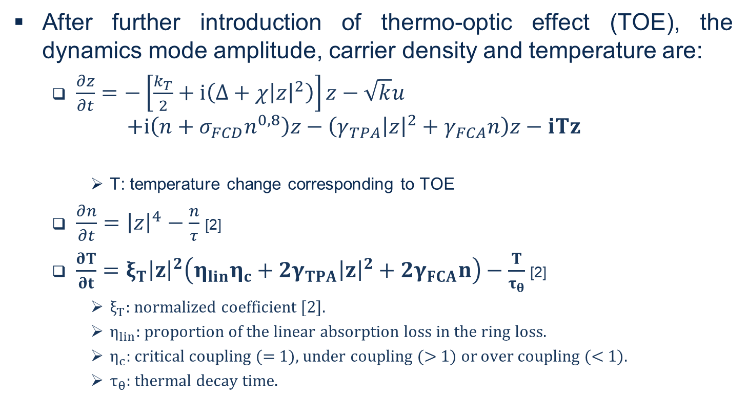
Single Resonator with Kerr, FCE and TOE
After further introduction of thermo-optic effect (TOE), the dynamics mode amplitude, carrier density and temperature are:
$\frac{∂z}{∂t}=−\left[\frac{k_{T}}{2}+ⅈ\left(Δ+χ{\left|z\right|}^{2}\right)\right]z−\sqrt{k}u$
$$+ⅈ\left(n+σ_{FCD}n^{0,8}\right)z−\left(γ_{TPA}{\left|z\right|}^{2}+γ_{FCA}n\right)z−iTz$$
T: temperature change corresponding to TOE
$\frac{∂n}{∂t}={\left|z\right|}^{4}−\frac{n}{τ}$ [2]
$\frac{∂T}{∂t}=ξ_{T}{\left|z\right|}^{2}\left(η_{lin}η_{c}+2γ_{TPA}{\left|z\right|}^{2}+2γ_{FCA}n\right)−\frac{T}{τ_{θ}}$ [2]
$ξ_{T}$: normalized coefficient [2].
$η_{lin}$: proportion of the linear absorption loss in the ring loss.
$η_{c}$: critical coupling (= 1), under coupling (> 1) or over coupling (< 1).
$τ_{θ}$: thermal decay time.
refractive index change induced by TOE [2]
[2] Zhang, Libin, et al. "Multibistability and self-pulsation in nonlinear high-Q silicon microring resonators considering thermo-optical effect." Physical Review A—Atomic, Molecular, and Optical Physics 87.5 (2013): 053805.

Slide 12
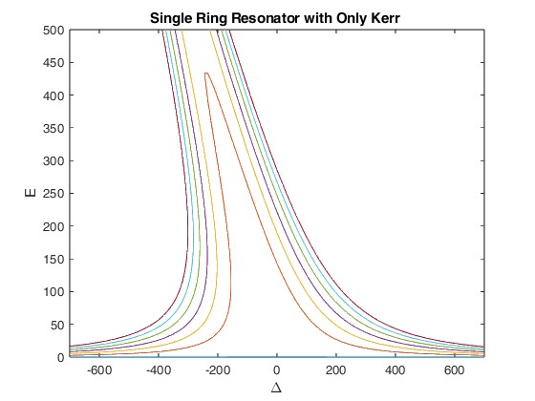
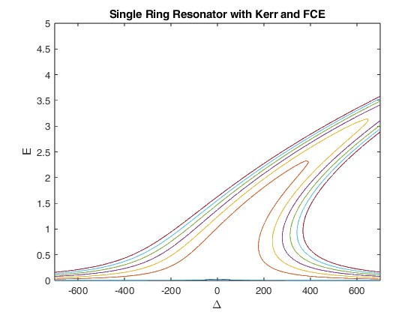
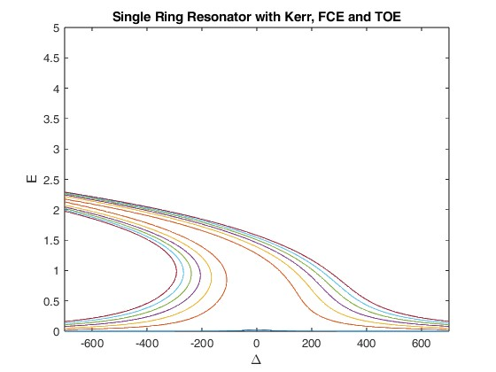
Bifurcation Diagram and Bistability
Kerr, TOE: red shift
FCD: blue shift
Notes:
red for the thermo-optic shift and blue for the free-carrier dispersion
“Such large circulating intensities can result in significant two-photon absorption (TPA) producing heat, free-carriers, and other nonlinearities. The generated free-carriers produce dispersion (FCD), and are themselves optically absorbing (FCA) which produces more heat. The refractive index seen by the circulating light within the microdisk is modified both by the stored thermal energy (phonons) within the microdisk through the thermo-optic effect, and by the dispersion due to the excess of free-carriers. These two effects produce competing shifts in the resonance wavelength of WGMs of the microdisk, red for the thermo-optic shift and blue for the free-carrier dispersion. The shift in the resonance wavelength and the nonlinear absorption in turn alters the circulating optical intensity, which then feeds back and modifies the generation rate of heat and free-carriers. “ -- Self-induced optical modulation of the transmission through a high-Q silicon microdisk resonator

Slide 13
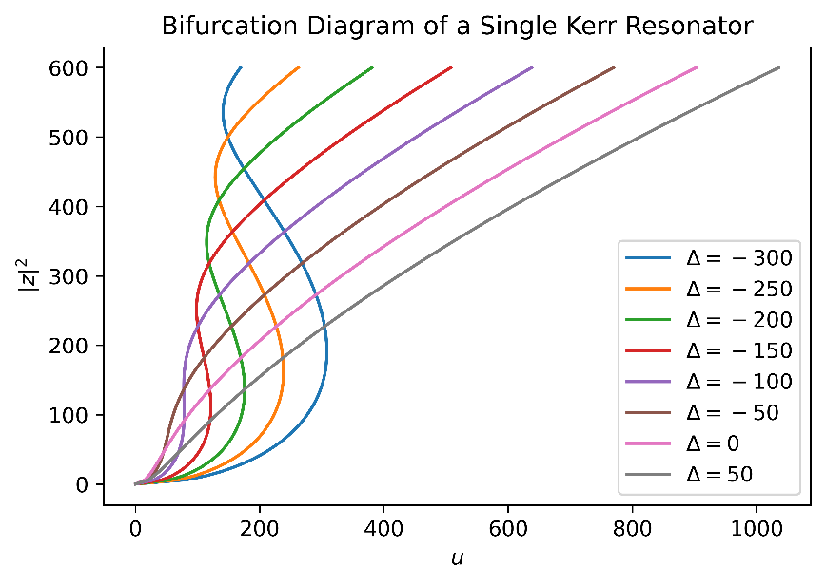
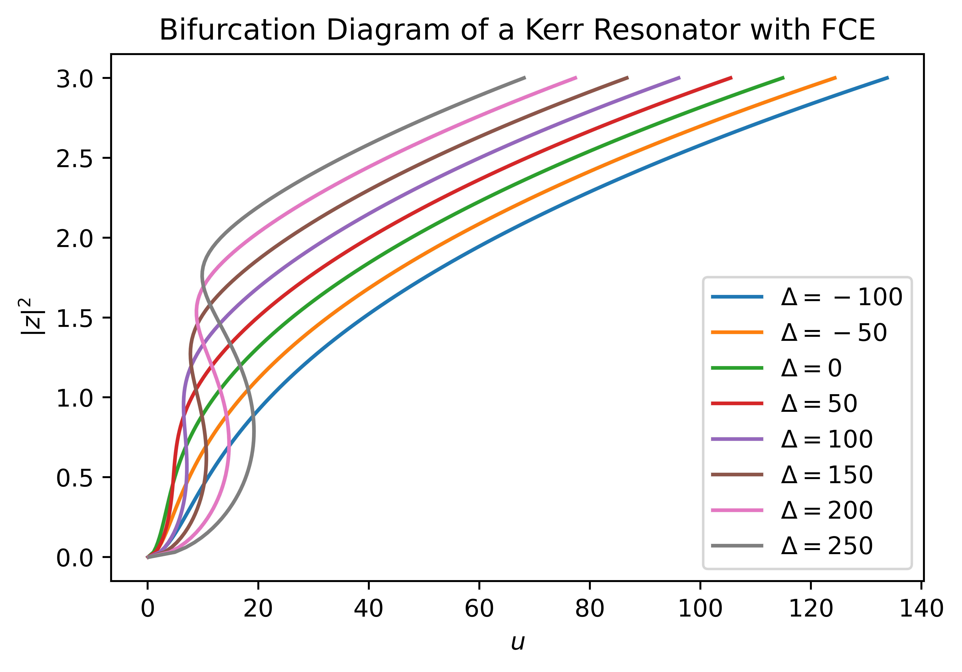
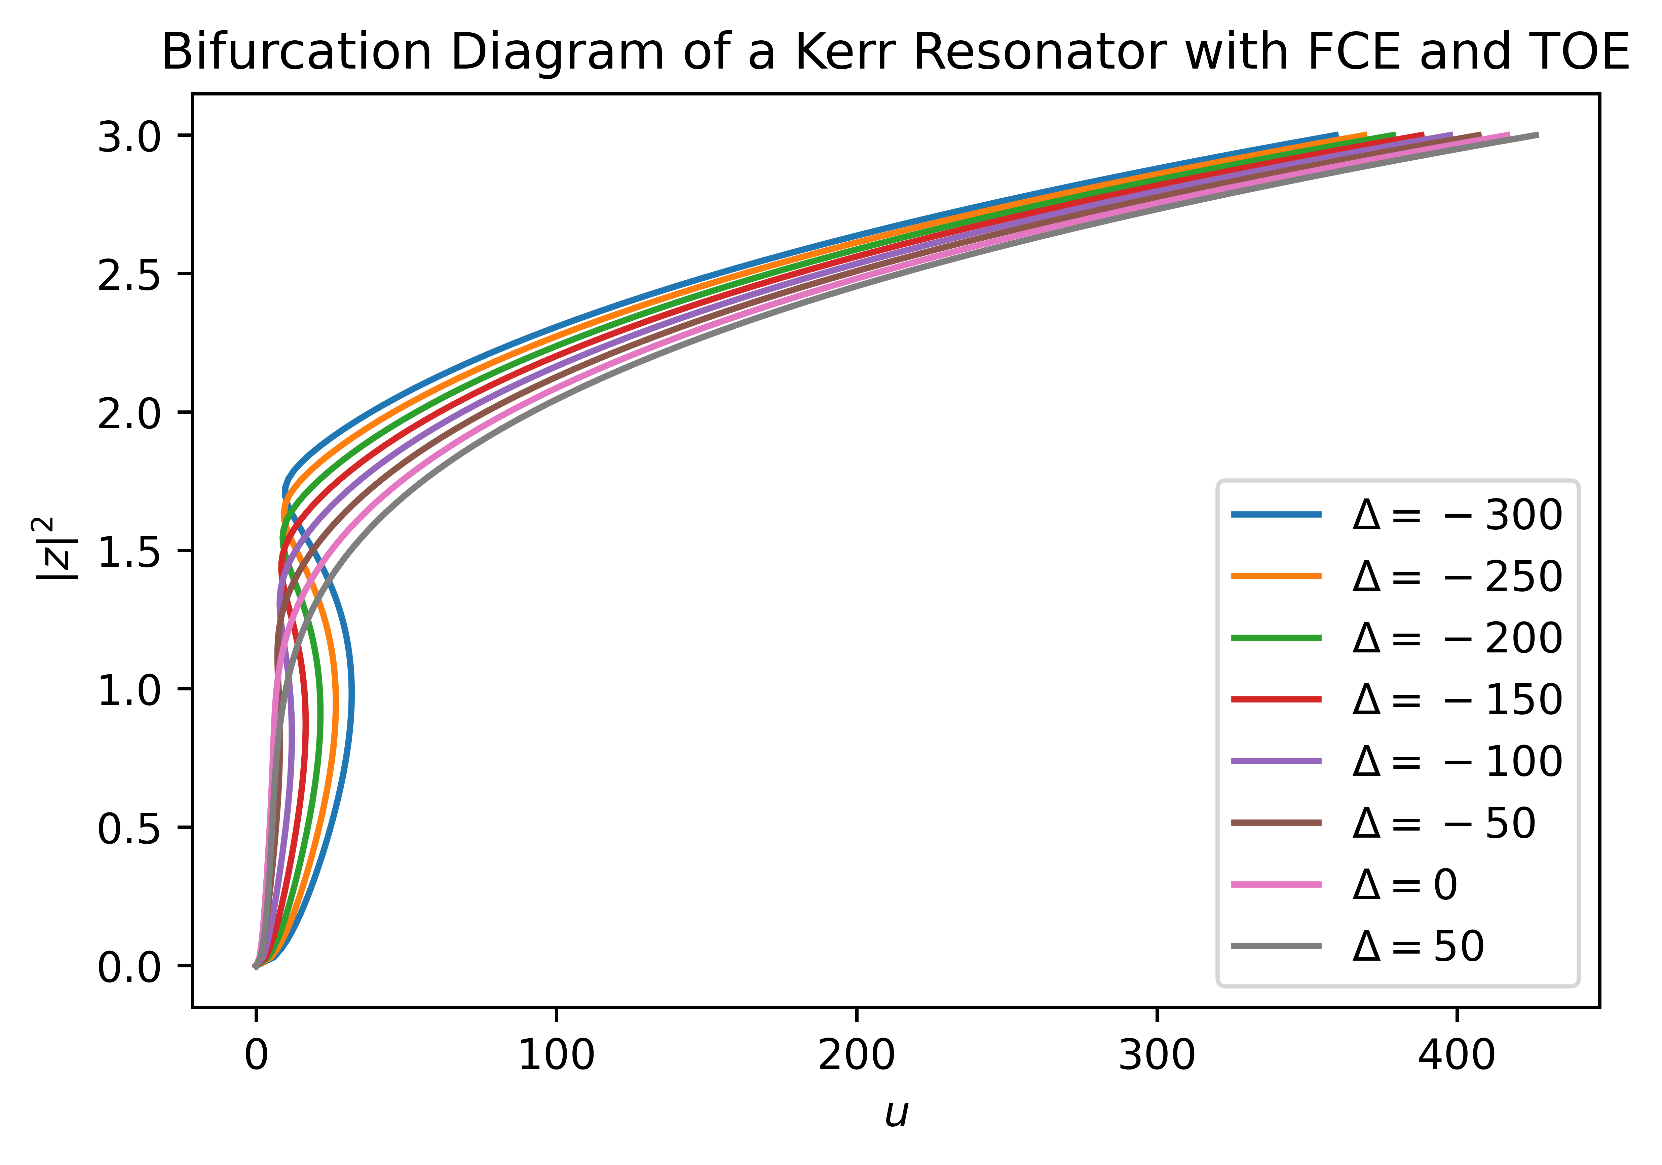
Bifurcation Diagram and Bistability

Slide 14
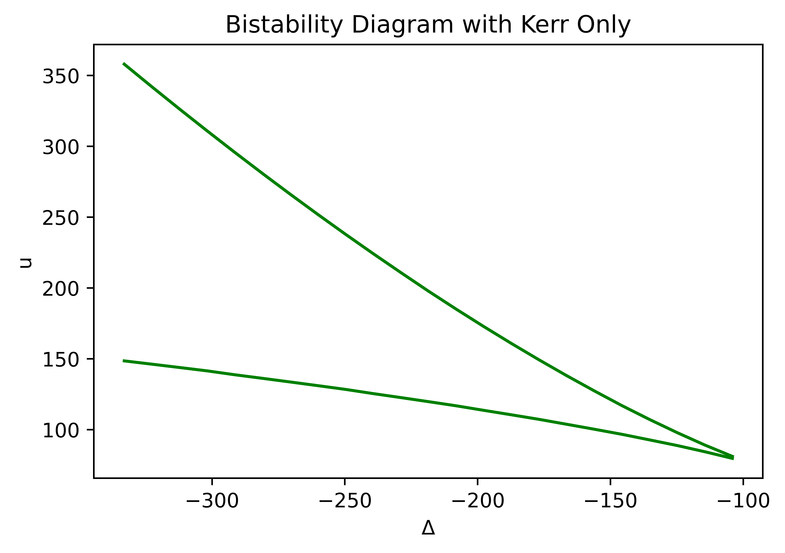
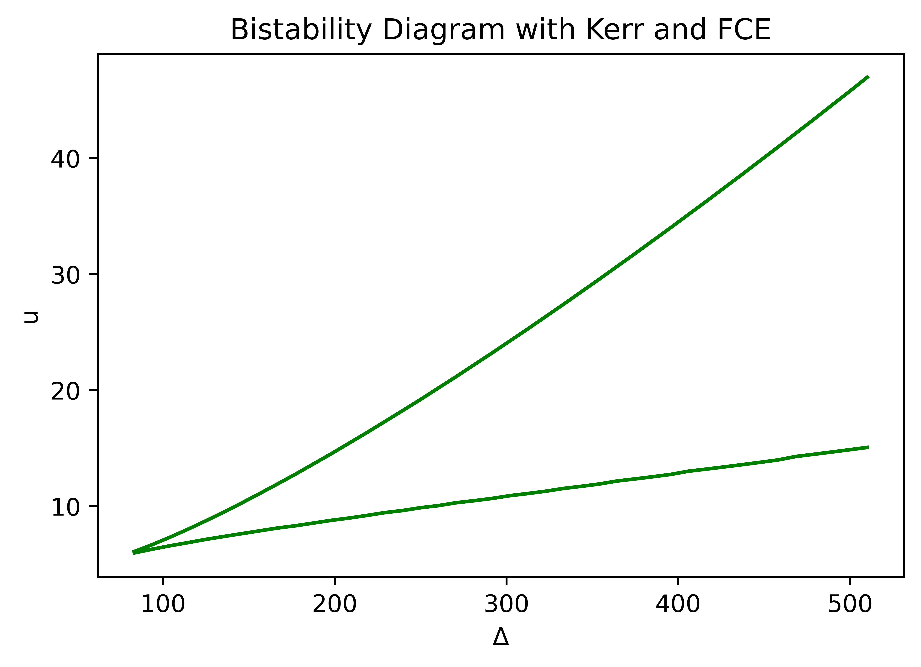
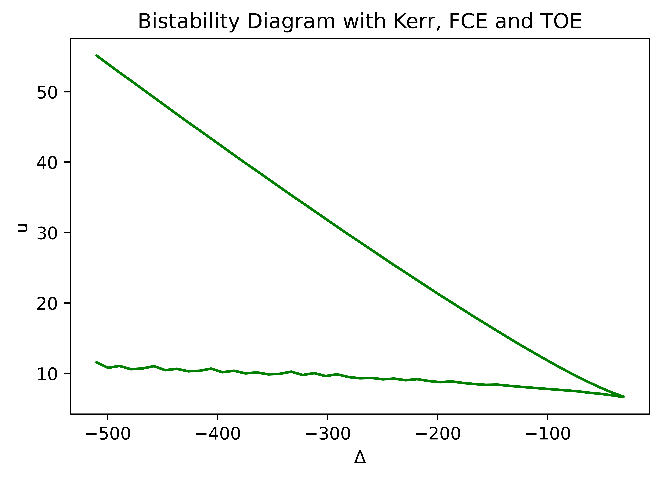
BI Boundaries Input Amplitude versus Frequency Detuning

Slide 15
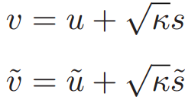
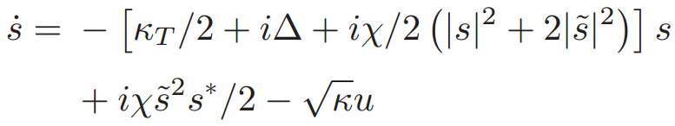
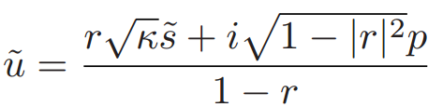
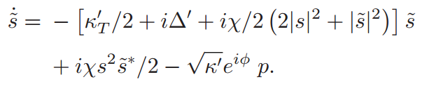
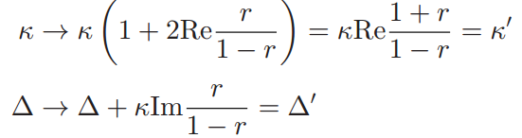
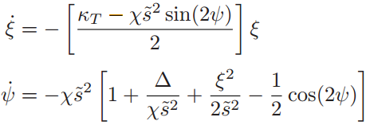
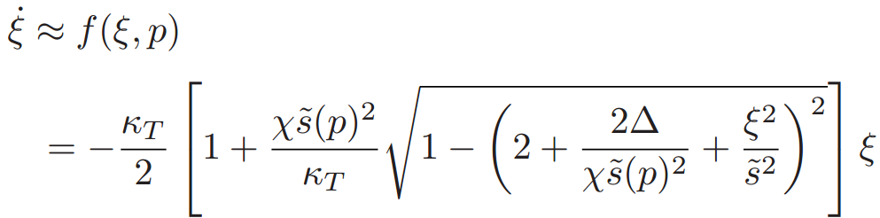
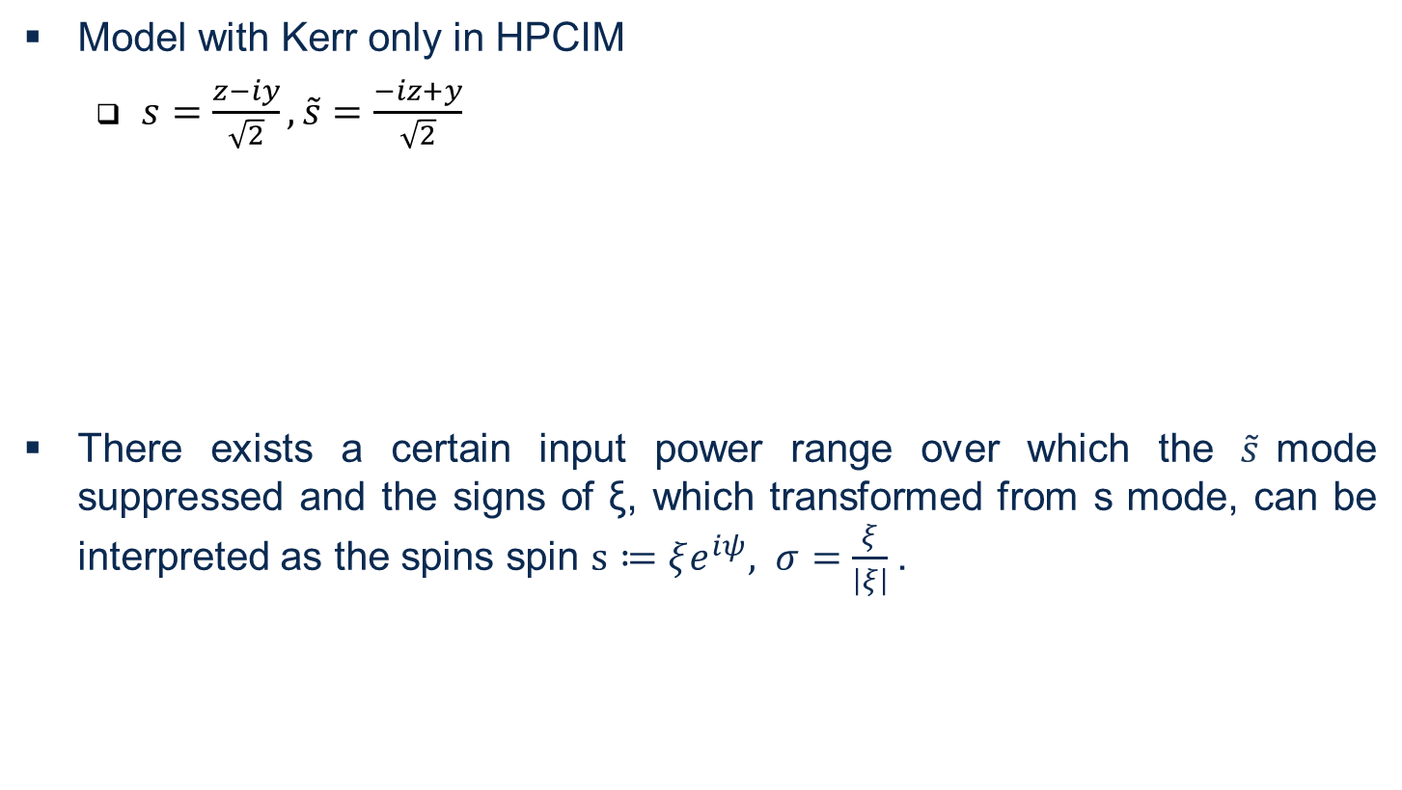
CIM Model with Kerr
Model with Kerr only in HPCIM
$s=\frac{z−iy}{\sqrt{2}},\tilde{s}=\frac{−iz+y}{\sqrt{2}}$
There exists a certain input power range over which the $\tilde{s}$mode suppressed and the signs of ξ, which transformed from s mode, can be interpreted as the spins spin $s≔ξe^{iψ}, σ=\frac{ξ}{\left|ξ\right|}$.
Common
Mode
Anti-correlated
Mode
r
[1] Tezak, Nikolas, et al. "Integrated coherent Ising machines based on self-phase modulation in microring resonators." IEEE Journal of Selected Topics in Quantum Electronics 26.1 (2019): 1-15.

Slide 16
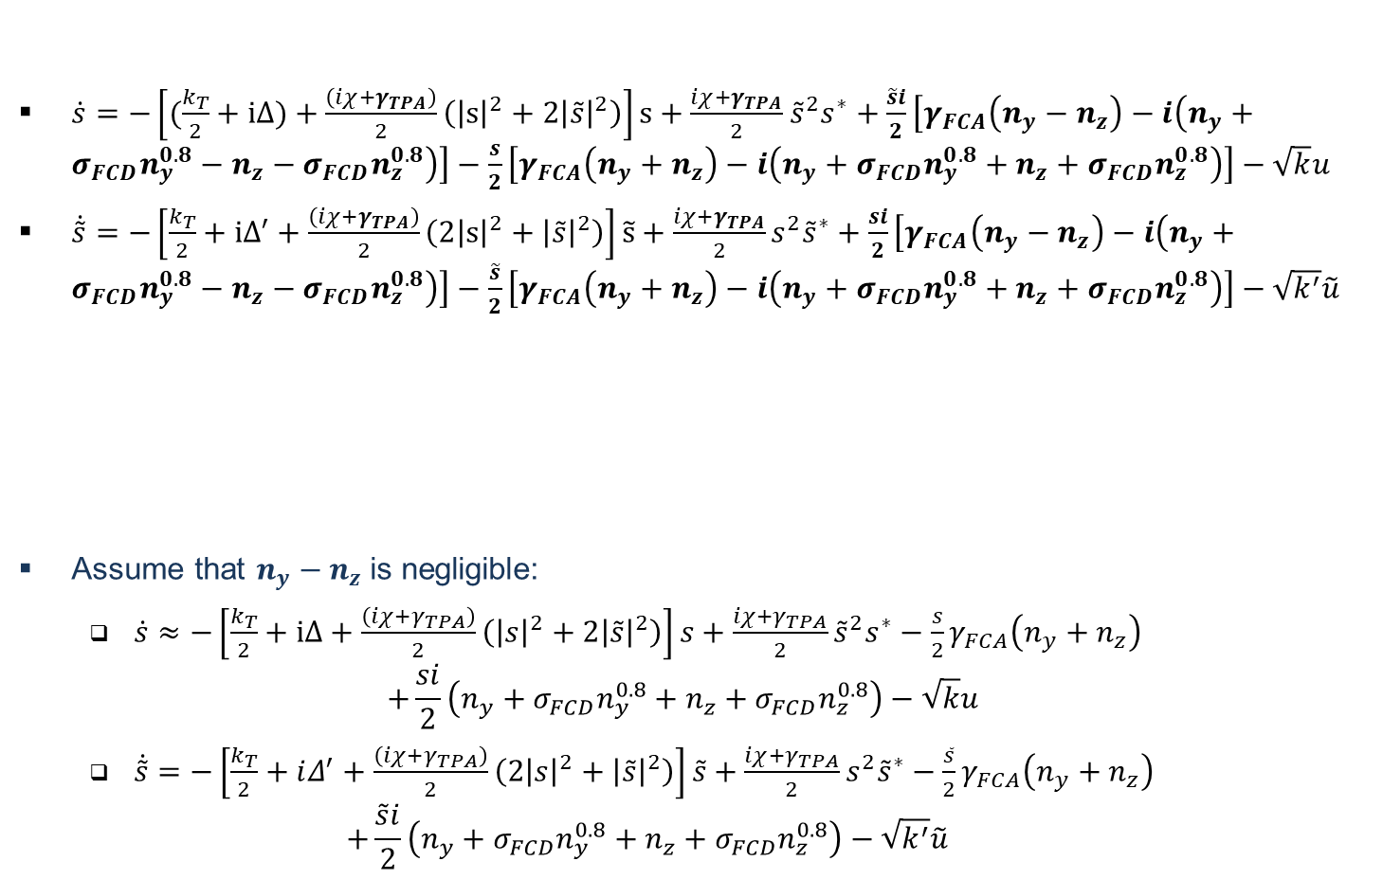
CIM Model with Kerr and FCE
$\dot{s}=−\left[(\frac{k_{T}}{2}+ⅈΔ)+\frac{\left(iχ+γ_{TPA}\right)}{2}\left({\left|s\right|}^{2}+2{\left|\tilde{s}\right|}^{2}\right)\right]s+\frac{iχ+γ_{TPA}}{2}$ ${\tilde{s}}^{2}s^{∗}+\frac{\tilde{s}i}{2}\left[γ_{FCA}\left(n_{y}−n_{z}\right)−i\left(n_{y}+{σ_{FCD}n}_{y}^{0.8}−n_{z}−{σ_{FCD}n}_{z}^{0.8}\right)\right]−\frac{s}{2}\left[γ_{FCA}\left(n_{y}+n_{z}\right)−i\left(n_{y}+{σ_{FCD}n}_{y}^{0.8}+n_{z}+{σ_{FCD}n}_{z}^{0.8}\right)\right]−\sqrt{k}u$
$\dot{\tilde{s}}=−\left[\frac{k_{T}}{2}+ⅈΔ^{′}+\frac{\left(iχ+γ_{TPA}\right)}{2}\left({2\left|s\right|}^{2}+{\left|\tilde{s}\right|}^{2}\right)\right]\tilde{s}+\frac{iχ+γ_{TPA}}{2}s^{2}{\tilde{s}}^{∗}+\frac{si}{2}\left[γ_{FCA}\left(n_{y}−n_{z}\right)−i\left(n_{y}+{σ_{FCD}n}_{y}^{0.8}−n_{z}−{σ_{FCD}n}_{z}^{0.8}\right)\right]−\frac{\tilde{s}}{2}\left[γ_{FCA}\left(n_{y}+n_{z}\right)−i\left(n_{y}+{σ_{FCD}n}_{y}^{0.8}+n_{z}+{σ_{FCD}n}_{z}^{0.8}\right)\right]−\sqrt{k^{′}}\tilde{u}$
Assume that $n_{y}−n_{z}$ is negligible:
$\dot{s}≈−\left[\frac{k_{T}}{2}+ⅈΔ+\frac{\left(iχ+γ_{TPA}\right)}{2}\left({\left|s\right|}^{2}+2{\left|\tilde{s}\right|}^{2}\right)\right]s+\frac{iχ+γ_{TPA}}{2}{\tilde{s}}^{2}s^{∗}−\frac{s}{2}γ_{FCA}\left(n_{y}+n_{z}\right)$
$$+\frac{si}{2}\left(n_{y}+{σ_{FCD}n}_{y}^{0.8}+n_{z}+{σ_{FCD}n}_{z}^{0.8}\right)−\sqrt{k}u$$
$\dot{\tilde{s}}=−\left[\frac{k_{T}}{2}+ⅈΔ^{′}+\frac{\left(iχ+γ_{TPA}\right)}{2}\left({2\left|s\right|}^{2}+{\left|\tilde{s}\right|}^{2}\right)\right]\tilde{s}+\frac{iχ+γ_{TPA}}{2}s^{2}{\tilde{s}}^{∗}−\frac{\tilde{s}}{2}γ_{FCA}\left(n_{y}+n_{z}\right)$
$$+\frac{\tilde{s}i}{2}\left(n_{y}+{σ_{FCD}n}_{y}^{0.8}+n_{z}+{σ_{FCD}n}_{z}^{0.8}\right)−\sqrt{k^{′}}\tilde{u}$$

Slide 17
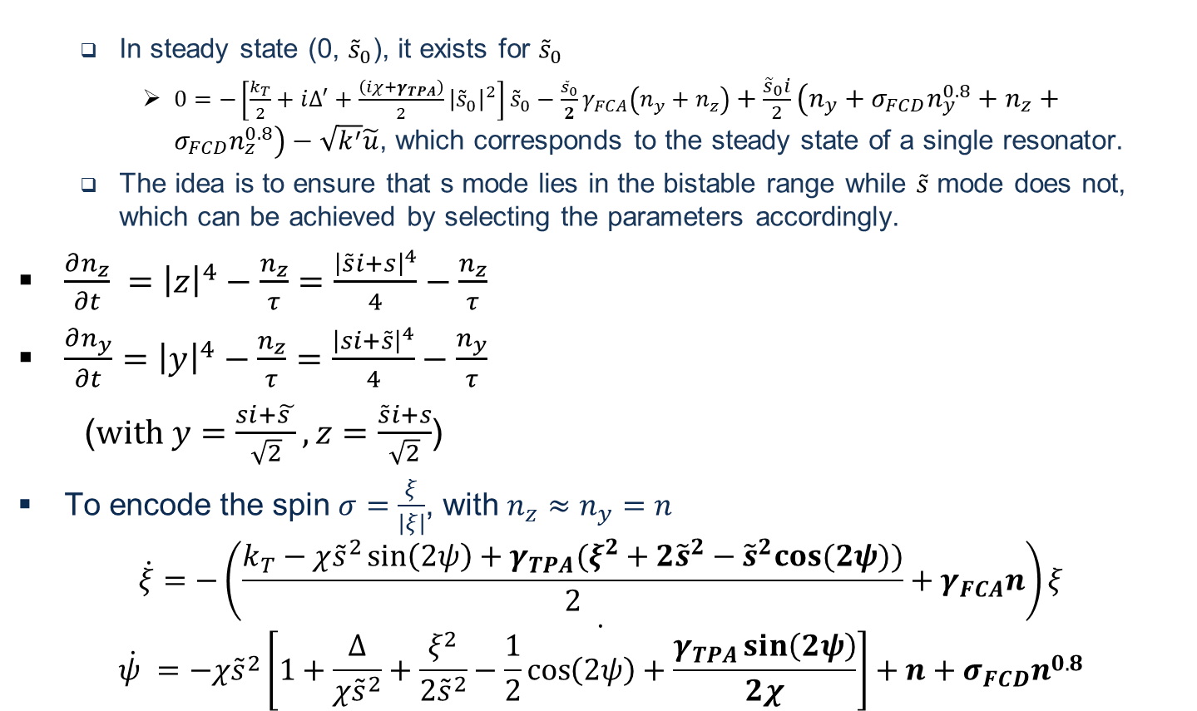
CIM Model with Kerr and FCE
In steady state (0, ${\tilde{s}}_{0}$), it exists for ${\tilde{s}}_{0}$
$0=−\left[\frac{k_{T}}{2}+ⅈΔ^{′}+\frac{\left(iχ+γ_{TPA}\right)}{2}{\left|{\tilde{s}}_{0}\right|}^{2}\right]{\tilde{s}}_{0}−\frac{{\tilde{s}}_{0}}{2}γ_{FCA}\left(n_{y}+n_{z}\right)+\frac{{\tilde{s}}_{0}i}{2}\left(n_{y}+{σ_{FCD}n}_{y}^{0.8}+n_{z}+{σ_{FCD}n}_{z}^{0.8}\right)−\sqrt{k^{′}}\tilde{u}$, which corresponds to the steady state of a single resonator.
The idea is to ensure that s mode lies in the bistable range while $\tilde{s}$ mode does not, which can be achieved by selecting the parameters accordingly.
$\frac{∂n_{z}}{∂t} ={\left|z\right|}^{4}−\frac{n_{z}}{τ}=\frac{{\left|\tilde{s}i+s\right|}^{4}}{4}−\frac{n_{z}}{τ}$
$\frac{∂n_{y}}{∂t}={\left|y\right|}^{4}−\frac{n_{z}}{τ}=\frac{{\left|si+\tilde{s}\right|}^{4}}{4}−\frac{n_{y}}{τ}$
($with y=\frac{si+\tilde{s }}{\sqrt{2}},z=\frac{\tilde{s}i+s}{\sqrt{2}}$)
To encode the spin $σ=\frac{ξ}{\left|ξ\right|}$, with $n_{z}≈n_{y}=n$
$$\dot{ξ}=−\left(\frac{k_{T}−χ{\tilde{s}}^{2}\sin\left(2ψ\right)+γ_{TPA}(ξ^{2}+2{\tilde{s}}^{2}−{\tilde{s}}^{2}cos⁡(2ψ))}{2}+γ_{FCA}n\right)ξ$$
$$\dot{\dot{ψ} =−χ{\tilde{s}}^{2}\left[1+\frac{Δ}{χ{\tilde{s}}^{2}}+\frac{ξ^{2}}{2{\tilde{s}}^{2}}−\frac{1}{2}\cos\left(2ψ\right)+\frac{γ_{TPA}\sin\left(2ψ\right)}{2χ}\right]+n+σ_{FCD}n^{0.8}}$$
HPCIM

Slide 18
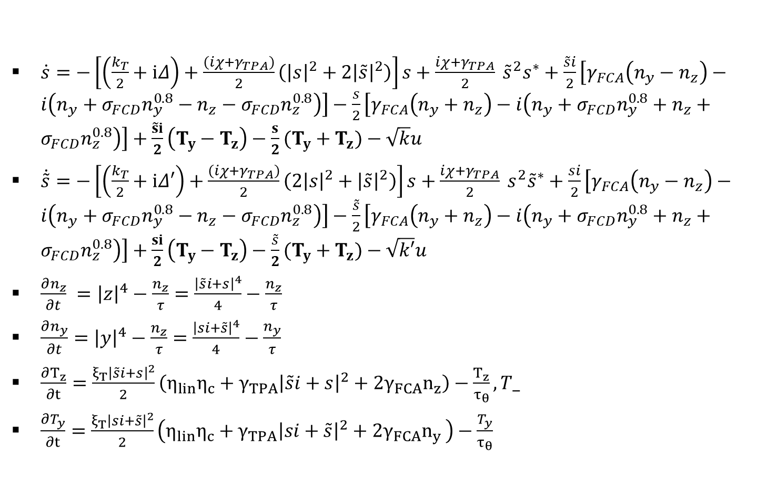
CIM Model with Kerr, FCE and TOE
$\dot{s}=−\left[\left(\frac{k_{T}}{2}+ⅈΔ\right)+\frac{\left(iχ+γ_{TPA}\right)}{2}\left({\left|s\right|}^{2}+2{\left|\tilde{s}\right|}^{2}\right)\right]s+\frac{iχ+γ_{TPA}}{2} {\tilde{s}}^{2}s^{∗}+\frac{\tilde{s}i}{2}\left[γ_{FCA}\left(n_{y}−n_{z}\right)−i\left(n_{y}+{σ_{FCD}n}_{y}^{0.8}−n_{z}−{σ_{FCD}n}_{z}^{0.8}\right)\right]−\frac{s}{2}\left[γ_{FCA}\left(n_{y}+n_{z}\right)−i\left(n_{y}+{σ_{FCD}n}_{y}^{0.8}+n_{z}+{σ_{FCD}n}_{z}^{0.8}\right)\right]+\frac{\tilde{s}i}{2}\left(T_{y}−T_{z}\right)−\frac{s}{2}(T_{y}+T_{z})−\sqrt{k}u$
$\dot{\tilde{s}}=−\left[\left(\frac{k_{T}}{2}+ⅈΔ′\right)+\frac{\left(iχ+γ_{TPA}\right)}{2}\left({2\left|s\right|}^{2}+{\left|\tilde{s}\right|}^{2}\right)\right]s+\frac{iχ+γ_{TPA}}{2} s^{2}{\tilde{s}}^{∗}+\frac{si}{2}\left[γ_{FCA}\left(n_{y}−n_{z}\right)−i\left(n_{y}+{σ_{FCD}n}_{y}^{0.8}−n_{z}−{σ_{FCD}n}_{z}^{0.8}\right)\right]−\frac{\tilde{s}}{2}\left[γ_{FCA}\left(n_{y}+n_{z}\right)−i\left(n_{y}+{σ_{FCD}n}_{y}^{0.8}+n_{z}+{σ_{FCD}n}_{z}^{0.8}\right)\right]+\frac{si}{2}\left(T_{y}−T_{z}\right)−\frac{\tilde{s}}{2}(T_{y}+T_{z})−\sqrt{k′}u$
$\frac{∂n_{z}}{∂t} ={\left|z\right|}^{4}−\frac{n_{z}}{τ}=\frac{{\left|\tilde{s}i+s\right|}^{4}}{4}−\frac{n_{z}}{τ}$
$\frac{∂n_{y}}{∂t}={\left|y\right|}^{4}−\frac{n_{z}}{τ}=\frac{{\left|si+\tilde{s}\right|}^{4}}{4}−\frac{n_{y}}{τ}$
$\frac{∂T_{z}}{∂t}=\frac{ξ_{T}{\left|\tilde{s}i+s\right|}^{2}}{2}\left(η_{lin}η_{c}+γ_{TPA}{\left|\tilde{s}i+s\right|}^{2}+2γ_{FCA}n_{z}\right)−\frac{T_{z}}{τ_{θ}}, T_$
$\frac{∂T_{y}}{∂t}=\frac{ξ_{T}{\left|si+\tilde{s}\right|}^{2}}{2}\left(η_{lin}η_{c}+γ_{TPA}{\left|si+\tilde{s}\right|}^{2}+2γ_{FCA}n_{y }\right)−\frac{T_{y}}{τ_{θ}}$

Slide 19
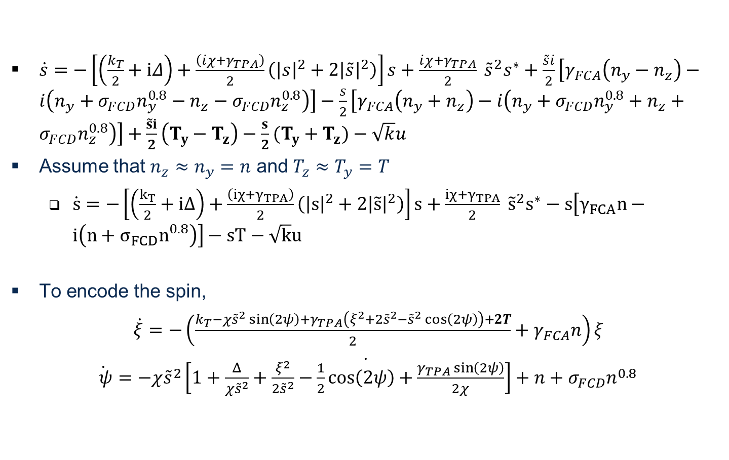
CIM Model with Kerr, FCE and TOE
$\dot{s}=−\left[\left(\frac{k_{T}}{2}+ⅈΔ\right)+\frac{\left(iχ+γ_{TPA}\right)}{2}\left({\left|s\right|}^{2}+2{\left|\tilde{s}\right|}^{2}\right)\right]s+\frac{iχ+γ_{TPA}}{2} {\tilde{s}}^{2}s^{∗}+\frac{\tilde{s}i}{2}\left[γ_{FCA}\left(n_{y}−n_{z}\right)−i\left(n_{y}+{σ_{FCD}n}_{y}^{0.8}−n_{z}−{σ_{FCD}n}_{z}^{0.8}\right)\right]−\frac{s}{2}\left[γ_{FCA}\left(n_{y}+n_{z}\right)−i\left(n_{y}+{σ_{FCD}n}_{y}^{0.8}+n_{z}+{σ_{FCD}n}_{z}^{0.8}\right)\right]+\frac{\tilde{s}i}{2}\left(T_{y}−T_{z}\right)−\frac{s}{2}(T_{y}+T_{z})−\sqrt{k}u$
Assume that $n_{z}≈n_{y}=n$ and $T_{z}≈T_{y}=T$
$\dot{s}=−\left[\left(\frac{k_{T}}{2}+ⅈΔ\right)+\frac{\left(iχ+γ_{TPA}\right)}{2}\left({\left|s\right|}^{2}+2{\left|\tilde{s}\right|}^{2}\right)\right]s+\frac{iχ+γ_{TPA}}{2} {\tilde{s}}^{2}s^{∗}−s\left[γ_{FCA}n−i\left(n+{σ_{FCD}n}_{}^{0.8}\right)\right]−sT−\sqrt{k}u$
To encode the spin,
$\dot{ξ}=−\left(\frac{k_{T}−χ{\tilde{s}}^{2}\sin\left(2ψ\right)+γ_{TPA}\left(ξ^{2}+2{\tilde{s}}^{2}−{\tilde{s}}^{2}\cos\left(2ψ\right)\right)+2T}{2}+γ_{FCA}n\right)ξ$
$\dot{\dot{ ψ}=−χ{\tilde{s}}^{2}\left[1+\frac{Δ}{χ{\tilde{s}}^{2}}+\frac{ξ^{2}}{2{\tilde{s}}^{2}}−\frac{1}{2}\cos\left(2ψ\right)+\frac{γ_{TPA}\sin\left(2ψ\right)}{2χ}\right]+n+σ_{FCD}n^{0.8}}$

Slide 20
Thank you!

